Slide 1

UnitedHealthcare
You
IL Individual & Family Exchange Plans 2023
1

Slide 2

Jeff Dekker
IFP Agency Manager - Illinois
Jeff_dekker@uhc.com
920-857-7979
Notes:
I would like to introduce you to our Central Region Team!
Jeff Dekker - IL
Erin Stout – MI e& IL
JP De La Cruz –TX & OK
And Carlos – our new 2023 states KS and MO.
Sonia Porras - TX
Jessica Lopez - TX
Please note their contact information – we will also have slide at the end of the presentation

Slide 3

Huge Opportunity Exists during Medicaid Redetermination!
Notes:
What is Medicaid Redetermination?

Slide 4





Medicaid Redetermination
      What is Medicaid Redetermination?
The Opportunity
      Medicaid redetermination, also called renewal or recertification, is a process where Medicaid members must demonstrate continued eligibility for Medicaid access, or they will lose access to Medicaid.
89M People enrolled in Medicaid
79M Individuals still eligible for Medicaid
10M People expected to lose Medicaid at the end of the PHE
After the PHE, nearly 10 million people will lose eligibility and will be eligible for other types of coverage (i.e. plans through the Exchanges or employer-sponsored coverage.)
Medicaid redeterminations have been paused during the
COVID-19 Public Health Emergency (PHE).
States received enhanced funding to keep members enrolled
Due to passage of recent legislation, starting April 1st , 2023, States can resume Medicaid redetermination
Separate from PHE ending
Unwinding Plans Vary by State
Duration of unwinding could be 9-14 months over 2023/2024
Retain Members or Transition Medicaid Ineligible Beneficiaries to Other Coverage
UnitedHealthcare Individual & Family ACA Marketplace Coverage (or Employer)
Notes:
The opportunity exists to educate and inform these individuals about healthcare options in Illinois: 3.9 Million enrolled in Medicaid, approximately 600,000 will lose Medicaid insurance

Slide 5
Illinois Medicaid enrollment and terminations
3.9 million people in Illinois enrolled in Medicaid (compared to 2.9 million before pandemic)
Federal analysis estimates 17% of people will lose Medicaid insurance based on historical patterns = 700,000
Illinois Health and Family Services is more optimistic and believes the number will be around 400,000 losing coverage
Approximately half of those losing coverage are in Cook and surrounding counties

Slide 6
Illinois Medicaid enrollment by county – Nov 2022
County | Total
Cook | 1,358,812
DuPage | 127,384
Kane | 104,005
Kankakee | 27,761
Kendall | 17,882
Lake | 122,302
Macon | 29,410
Madison | 55,619
Monroe | 2,480
Sangamon | 46,357
Shelby | 4,030
St Clair | 66,921
Will | 115,865

Slide 7
Illinois Redetermination Dates
Redetermination due dates will spread over a 12 month period 6/1/2023 – 5/1/2024
No “coverage cliff”
Event | Date
Continuous coverage ends | 3/31/2023
First renewal notices sent by | 5/1/2023
Redetermination due date | 6/1/2023
Case closure date | 6/15/2023
First day of coverage loss | 7/1/2023
Last day to return for reinstatement | 9/30/2023
Second cohort renewal notices sent by | 6/1/2023

Slide 8
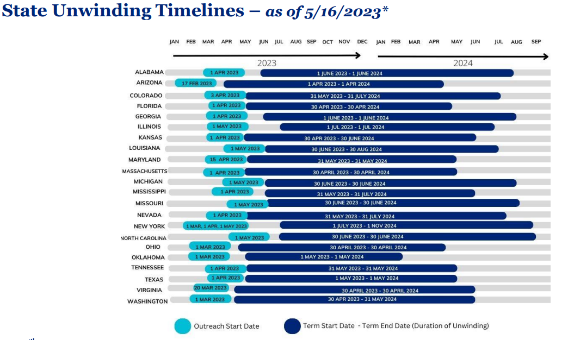

Slide 9
Unwinding SEP
Consumers who lose Medicaid or CHIP coverage between March 31, 2023 and July 31, 2024 will be eligible for a 60-day SEP beginning the day they submit or update a Marketplace application. Consumers will receive the Unwinding SEP automatically based on their answers to application questions.
For consumers who attest to a loss of Medicaid or CHIP coverage in the past, their Marketplace coverage will start the first of the month following plan selection. For example, if a consumer selects a plan on April 2, their coverage will start May 1.
For consumers who attest to a future loss of Medicaid or CHIP coverage, Marketplace coverage will start the first day of the month after their last day of Medicaid coverage. For example, if a consumer selects a plan on April but their Medicaid coverage isn’t ending until May 31, their coverage will start June 1.

Slide 10

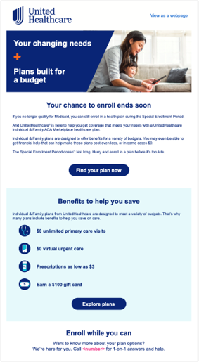

What is UnitedHealthcare doing?
      UnitedHealthcare National Go-T0-Market Strategy
      Focused on driving action to stay covered after losing Medicaid and highlighting benefits of Individual & Family ACA Marketplace Plans from UnitedHealthcare
      Direct Response
      Email
      Affiliate
      Digital Media
Video Samples***
Email Sample**
**Subject to change
Notes:
UHC recognizes the opportunity that exists as a result of Redetermination, we have created a national go-to-market strategy that is focused on driving action – the goal is to keep people covered after losing Medicaid. We want to highlight the benefits of our ACA plans and increase brand awareness. The campaign is using multiple channels including direct mail, e-mail, affiliate and digital media messages. The images on the right of this slide are examples of the pieces created for the campaign. The pieces are similar in that they draw attention to the problem - loss of Medicaid coverage, and highlight how UHC plans can help solve the problem.

Slide 11
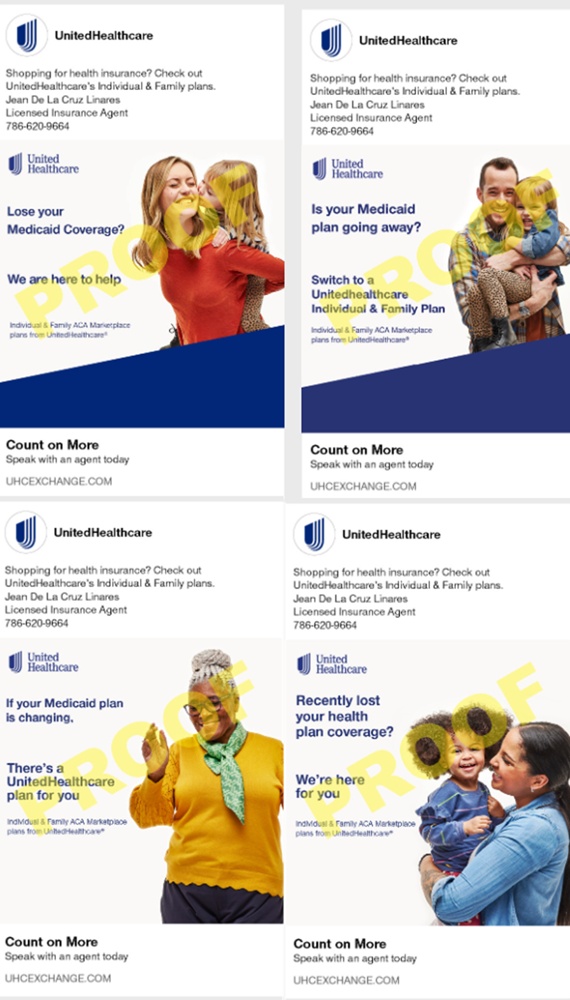

Agent Toolkit
      UnitedHealthcare Agent Toolkit Marketing Materials through Jarvis
      Customize flyers and other marketing materials with your information
      Medicaid Redetermination Flyer – 23PRJ79692
      SEP Flyer – 23SPRJ79700
      Facebook Ad – 23SPRJ74560
      Medicaid Redetermination Poster – 23SPRJ79693
      SEP Poster – 23SPRJ79704
Notes:
We also created materials to help agents with outreach and marketing efforts. These customizable pieces were created specifically for individuals losing Medicaid coverage and can be found in the Jarvis Toolkit. We have agent flyers, posters, facebook ad and consumer education checklist.

Slide 12
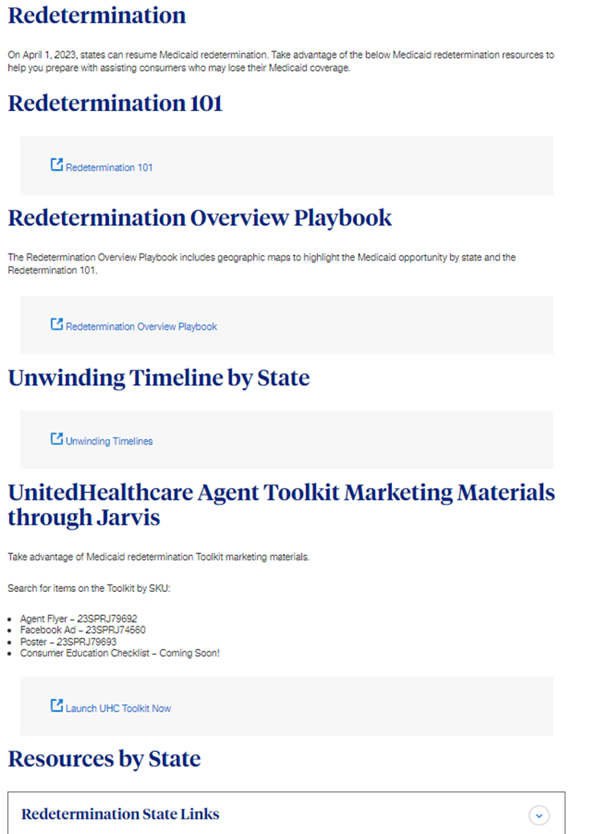
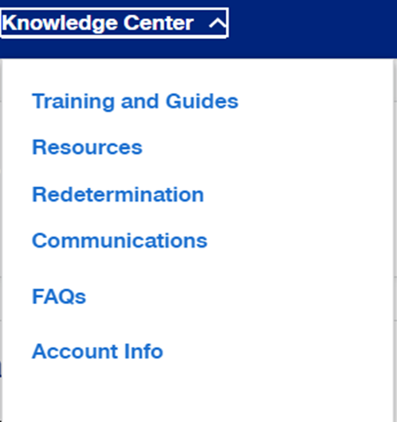
UHC Jarvis Resources
      Jarvis Redeterminations Page
      To access, go to Jarvis > Knowledge Center > Redetermination.
      One-pager for Brokers and Navigators (Redetermination Checklist for Member facing) on UnitedHealthcare Agent Toolkit
      Redetermination Overview for Brokers and Navigators
        (Non-Member Facing)
      Geographic Medicaid Opportunity by State
      State Timing Information​

Slide 13
Network and Footprint
Notes:
Today we will be talking about Virtual First Plans – These plans take an innovative approach to healthcare that focus on efficiency, efficacy, and affordability of healthcare delivery

Slide 14

Illinois 2023
Market Area | Counties | Hospitals, Affiliated Physicians, FQHCs and Clinics
Chicago | Cook, DuPage, Kane, Kankakee, Kendall, Lake, Will | Advent Health: Adventist Bolingbrook Hospital, Adventist Hinsdale Hospital, Adventist Glen Oaks Hospital, Adventist La Grange Memorial Hospital, Alexian Brothers Health System (Ascension): St. Alexius Medical Center, Alexian Brothers Medical Center, Community First Healthcare: Community First Medical Center, Duly Health and Care (Formerly DuPage Medical Group), Northshore University Health System: Edward Hospital, Elmhurst Memorial Hospital, Northwest Community Hospital, Northshore Evanston Hospital, Northshore Glenbrook Hospital, Northshore Highland Park Hospital, Northshore Skokie Hospital, Swedish Covenant Hospital, Presence Health (Ascension): Presence Holy Family Medical Center, Presence Resurrection Medical Center, Presence Saint Francis Hospital, Presence Saint Joseph Hospital Chicago, Presence Saint Joseph Hospital Elgin, Presence Saint Joseph Medical Center, Presence Saints Mary and Elizabeth Medical Center, Presence St. Mary's Hospital, Presence Saint Mercy Medical Center, Silver Cross Hospital, Pipeline Health: Louis A Weiss Memorial Hospital, West Suburban Medical Center, Sinai Health System: Holy Cross Hospital, Mount Sinai Hospital Medical Center, South Shore Hospital Illinois: St. Anthony Hospital, St. Bernard Hospital, Thorek Hospital Medical Center: Methodist Hospital of Chicago, Thorek Memorial Hospital, Vista Health: Vista Medical Center East
Springfield | Macon, Sangamon, Shelby | Hospital Sisters Health System: Good Shepherd Hospital, St. John's Hospital, St. Mary's Hospital
St. Louis (MO-IL) (Belleville) | Madison, Saint Clair, Monroe, St. Charles, St. Louis County, St. Louis City, Jefferson, Ste. Genevieve | Hospital Sisters Health System: St. Elizabeth Hospital, St. John's Hospital, Mercy Health System St. Louis: Mercy Hospital St. Louis, Mercy Hospital Jefferson, Mercy Hospital South, Mercy Rehabilitation Hospital of St. Louis, St. Luke's Hospital - Des Peres, Esse Physicians
The information described is confidential and proprietary. Plan and provider network information may be subject to change.
Notes:
Chicago: North Shore being added to Chicago network, we are also anchored in Advent Health system in Chicago.

Slide 15
Product
Notes:
Today we will be talking about Virtual First Plans – These plans take an innovative approach to healthcare that focus on efficiency, efficacy, and affordability of healthcare delivery

Slide 16
Product Families
Essential
lowest premium option, higher out-of-pocket costs, and $3 or less Tier 1 Preferred generics
B
S
G
Virtual First
24/7, $0, on-demand comprehensive virtual care at your fingertips via the Galileo mobile app
B
S
G
Value
go-to flagship plan, good fit for most, offered across all metal levels
B
S
G
one of the richer plans, some include dental and vision coverage for adults. Includes two new offerings – an all-copay plan and a $0 deductible plan
Advantage
B
S
G
The information described is confidential and proprietary. Plan and provider network information may be subject to change.
16

Slide 17






Virtual First Plans
Powered by
 | 24/7, $0 on-demand primary care at your fingertips
 | Galileo providers have access to expert consultation and will refer to in-network, high-value specialists when needed
 | End-to-end Spanish-speaking experience, including Spanish app and Spanish-speaking physicians
 | No surprise bills for care accessed through the mobile app
 | In-person primary care outside the Galileo app may cost members more out of pocket
17
Notes:
UHC is proud to offer our Virtual First Plans powered by Galileo. Galileo Health developed an innovative app for online doctor consultation. The company was founded by a harvard trained internist who put together a top notch team of physicians with a wide diversity in specialties. The Virtual First Plans give your members 24/7 on demand access to this group of doctors . The Galileo physicians take a collaborative approach to their consultation – drawing on the expertise of the group. Members don't have a single virual pcp – rather the entire Galileo team.
The Galileo physicians are able to make referrals for in-network specialist visits, for lab work, or imaging.
The plans offer an end-to-end Spanish speaking experience – including a Spanish version of the app and Spanish speaking physicians.
There is $0 charged for unlimited access to physicians through the mobile app. Members have the option to see in-network physicians at a physical (brick and mortar) location but a co-pay will apply.

Slide 18
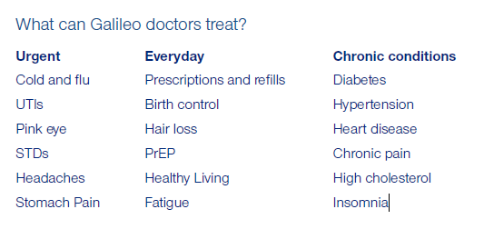

Virtual First Plans
Powered by
Convenient, 24/7 access to quality care and same day responses
Can prescribe medications and connect consumers to the right pharmacies, all from the Galileo app
All consumers are auto-assigned a PCP as part of UHC’s Individual & Family Plans
Galileo can also provide referrals for labs and imaging, if applicable. Consumers should always ask their virtual PCP for a referral before seeking specialty care.
18
Notes:
In Spanish as well – Spanish speaking providers and app language

Slide 19
Top 5 Plans in Illinois
Plan Name | Rank
UHC Bronze Virtual First | 1
UHC Bronze Standard 1 | 2
UHC Silver Advantage 1 | 3
UHC Bronze Value | 4
UHC Bronze Standard | 5

Slide 20




National Offerings
No cost doctor visits
$0 virtual urgent care and $0 primary care
Low-cost prescriptions
$3 or less Tier 1 & generics at Walgreens
$100 member reward
For completing 4 simple activities
Wellness on a budget
Complimentary one-year Peloton® fitness App Membership

Slide 21






Member Incentives Digital Fitness Free Memberships
Member Incentives*
Digital Fitness*
Free Membership
Increase incentive from $25 to $100
1-year Peloton® Digital Membership at no additional cost.
1-year AARP membership at no additional cost
Get rewarded in 4 easy steps:
1. Annual wellness visit with your primary care provider (PCP)
2. Turn on monthly autopay
3. Opt-in to paperless communications
4. Sign up to receive text messages
Choose your $100 gift card
Redeem your gift card at one of our participating retailers, including:
1. Enroll in a qualifying plan
2. Check eligibility and access code
3. Download the Peloton App
4. Redeem code and start membership!
1. Discounts on travel, groceries, resources and tools for financial planning and health living
2. Available to all Individual & Family Plan members
3. Website enrollment with promo-code
*Eligibility is limited to members ages 18+.

Slide 22
Dental Coverage
AL, AZ, FL, GA, IL, KS, LA, MD, MO, NC, OH, OK, TN, TX, VA
Service | IFP Adult Dental* | IFP Pediatric Dental
Plan Maximums / Eligibility | Network Only Benefits | Network Only Benefits
Age Requirement** | 19 years of age or older | 18 years of age and under
Dental Benefit Maximum | $1K per covered person per calendar year | N/A
Routine Dental Services – Class 1
Preventative and Diagnostic | No charge, subject to annual maximum | No charge
Diagnostic Services Oral Evaluation X-Rays
Intraoral/Extraoral Prophylaxis (except cone beams)
Basic Dental Care – Class 2
Minor restorative services | 50% coinsurance, subject to Annual Maximum | DED + COINS
Endodontics
Periodontics
Oral Surgery
Adjunctive Services
Major Dental Care – Class 3
Major restorative services | 50% coinsurance, subject to Annual Maximum | DED + COINS
Fixed Prosthetics and Removable Prosthetics
Orthodontia – Class 4
Orthodontia Services | Not Covered | DED + COINS
*Benefits do not apply towards annual OOPM or to the Deductible ** Members are covered on the pediatric benefit until the last day of the calendar month they turn 19
(Not covered in MI)
Notes:
We continue to offer adult Dental coverage in certain plans this year which is very popular.
Adult Dental coverage includes:
Benefits do not apply towards annual OOPM or to Deductible
$0 copays for routine dental visits, cleanings and x-rays
$1000 annual benefit
Major and Minor Restorative dental care (extractions, crowns, periodontics and more) at 50% coins up to the annual maximum
And access to a robust dental provider network – network is PPO20, but it is not a PPO plan
No waiting period to receive dental benefit.

Slide 23
Vision Coverage
AL, AZ, FL, GA, IL, KS, LA, MD, MI, MO, MS, NC, OH, OK, TN, TX, VA
Service | IFP Adult Vision* | IFP Pediatric Vision
Plan Maximums / Eligibility | Network Only Benefits
Age Requirement*** | 19 years of age or older | Age 18 and under
Vision Benefit Maximum | N/A | N/A
Exams | Once every 12 months
Comprehensive Vision Exam | No charge | No charge
Retinal Screening Photography | $39 copay | N/A
Materials | Once every 12 months
Lenses | $25 Copay | DED + COINS
(Includes standard scratch)
Polycarbonate Lenses | Not covered | No charge
Frames | Covered up to $130 | DED + COINS
Contact lens – formulary** | $25 Copay | DED + COINS
(Fit & evaluation included in copay for adults, no charge for pediatrics)
Contact Lens – Non-Formulary** | Covered up to $105 | Not covered
(materials copay doesn’t apply)
Low Vision Testing | N/A | No charge
Low Vision Therapy | N/A | 25% (not subject to deductible)
*Benefits do not apply towards annual OOPM or Deductible **Contact lenses are in lieu of lenses/frames *** Members are covered on the pediatric benefit until the last day of the calendar month they turn 19
Notes:
Adult Vision coverage:
We’ve enhanced our benefit this year
so now instead of paying a $10 copay for routine vision exam​, members will pay $0 for vision exams
Benefits do not apply towards annual Out of Pocket Max or deductible for adult
Frames covered up to $130​
Retinal screening - $39 copay
Price protection on popular lens options including high-index lenses, anti-reflective coating and tint​
$25 copay for scratch resistant lenses or formulary contact lenses*​
Access to a large network of eye-health providers and much more

Slide 24
Jarvis – Agent Portal

Slide 25
What can you find on Jarvis?
Application status
View Book of Business
Commission Statements
Knowledge Center:
  Communications
  Training videos
  FAQ’s
Tool Kit – Marketing Materials

Slide 26
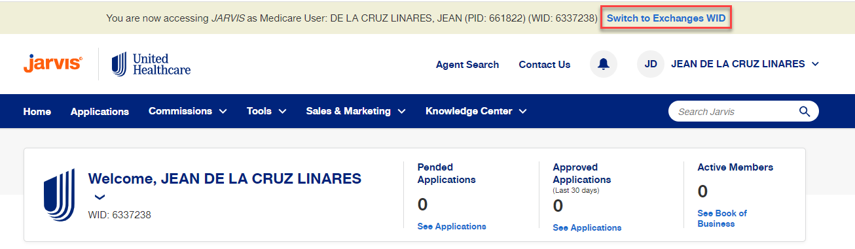
Jarvis
Notes:
If you need help logging into Jarivs – please call our ACA PHD – contact info is in our email signature and we can also put it in the chat now.
Once you log into Jarvis, please ensure you are on the ACA side. You can do this by finding the tan bar at the top and click “switch to Exchanges WID” You are able to toggle between Medicare and ACA.

Slide 27
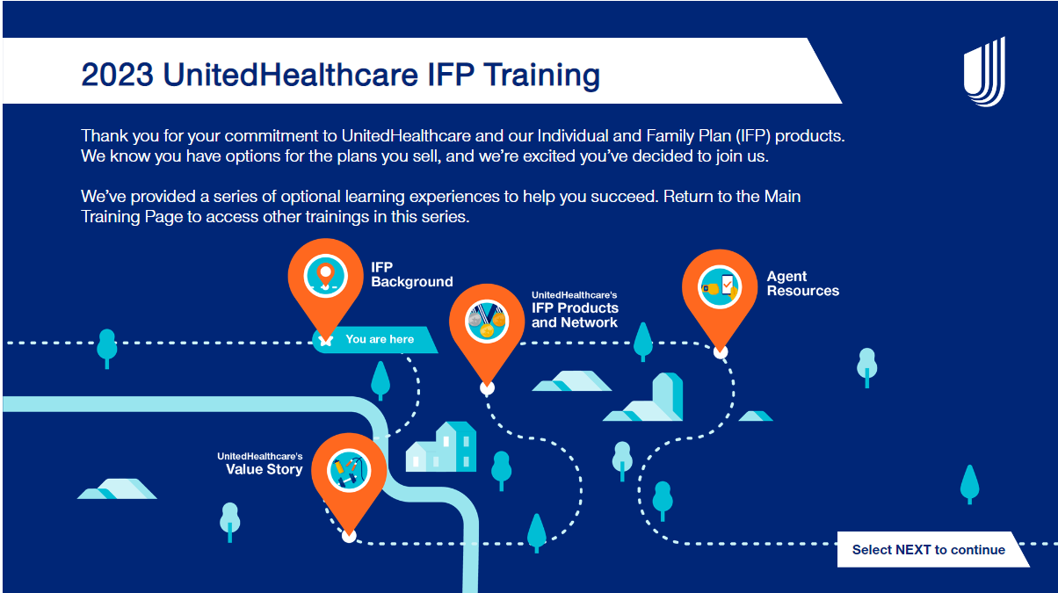
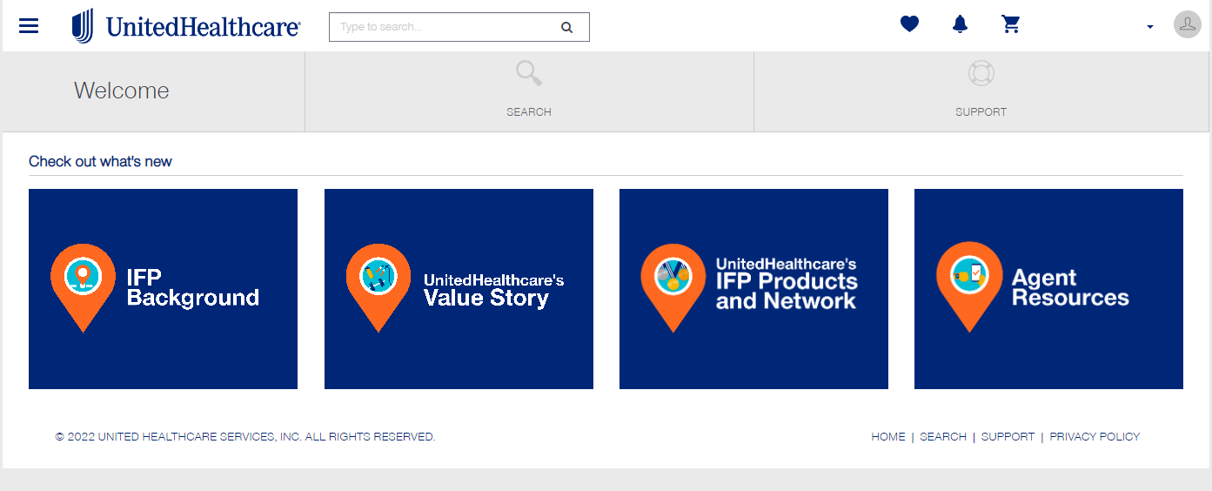
Jarvis - IFP Trainings
Now live!
IFP Background
UHC’s Value Story
Product and Network
Agent Resource
Notes:
In the Product and Networks module, you’ll learn about the offerings, benefits and provider networks that set our IFP plans apart from others in the marketplace. You’ll have the chance to view state-specific product and network information.
In the IFP Background module, you’ll get an overview of the IFP story, starting with the signing of the Patient Protection and Affordable Care Act (ACA) in 2010. You’ll learn about how IFP plans work and how the work you do impacts people who might not otherwise have access to health insurance.
(Agent Resources) This learning module covers the many ways UnitedHealthcare is here to assist you in the work you do. You'll have the chance to review many of the tools and resources available to support you during Open Enrollment and all year round.
In the Virtual First module, you'll learn more about our Virtual First family of products. Virtual First will be available in eight states for 2023 (Florida, Georgia, Illinois, Maryland, Michigan, Ohio, Texas, Virginia). If it is not offered in your state, there is no need for you to complete this module.

Slide 28
Notice of Benefit and Payment Parameters for 2024 Final Rule

Slide 29
Notice of Benefit and Payment Parameters for 2024 Final Rule
prioritizes equity, access, and affordability in the healthcare system:
  Easier to enroll in coverage:
        Creates permanent SEP for those losing Medicaid or CHiP
  Increasing access to health care services:
        Two new essential community provider (ECP) categories: Substance Abuse and Mental Health Facilities
  Simplifying choice and improving the plan selection process:
        limiting the number of non-standardized plan options: 4 non-standard plans by metal level
  Bolstering Program Integrity:
        Receipt of Consumer Consent
        Eligibility Application Confirmation

Slide 30
New Regulations – Effective June 18, 2023
    Receipt of Consumer Consent (permission to work together)
    Documentation must include:
    A description of the scope, purpose, and duration of the consent provided by the consumer of their authorized representative;
    The date the consent was given;
    The name of the consumer or their authorized representative;
    The name of the agent being granted consent
    The process through which the consumer or authorized representative may rescind the consent.
    Documentation must be maintained at least 10 years and made available upon request in response to monitoring, audit, and enforcement activities

Slide 31
New Regulations - continued
    Eligibility Application Confirmation (confirm eligibility application is accurate)
    Documentation must include:
    The date the information was reviewed
    The name of the consumer or their authorized representative
    An explanation of the attestations at the end of the eligibility application
    The name of the agent, broker, or web-broker providing the assistance
    The process through which a consumer can rescind consent
    Documentation must be maintained at least 10 years and made available upon request in response to monitoring, audit, and enforcement activities

Slide 32
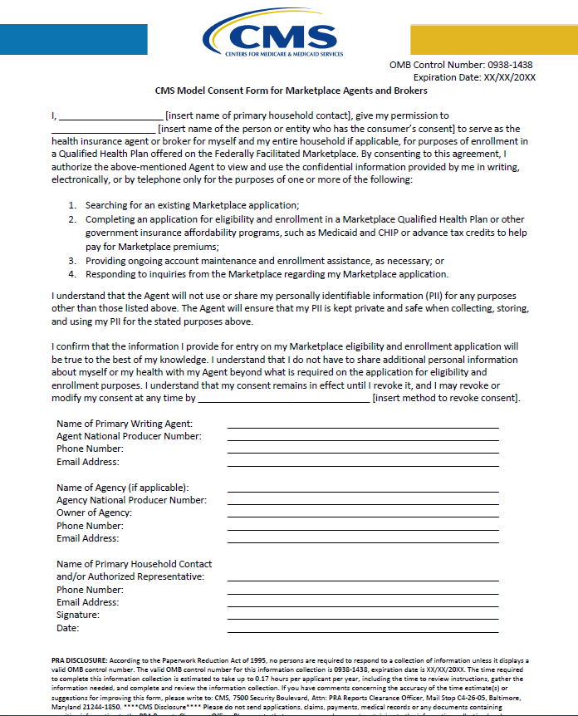
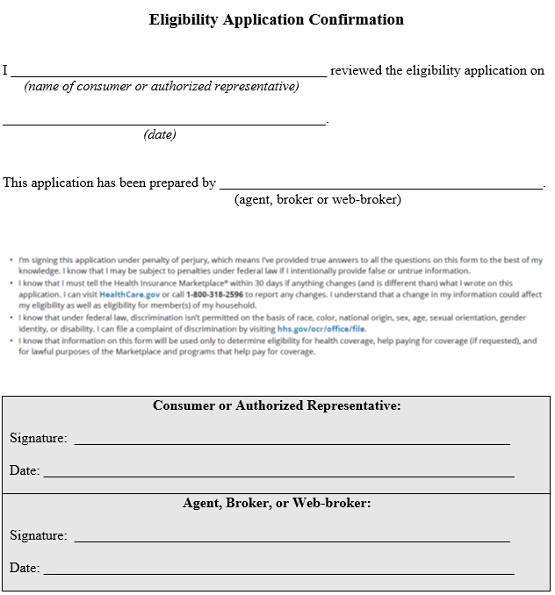

Slide 33
Thank You
UHC IFP Agency Manager - Illinois
Jeff_dekker@uhc.com
920-857-7979
Notes:
I would like to introduce you to our Central Region Team!
Jeff Dekker - IL
Erin Stout – MI e& IL
JP De La Cruz –TX & OK
And Carlos – our new 2023 states KS and MO.
Sonia Porras - TX
Jessica Lopez - TX
Please note their contact information – we will also have slide at the end of the presentation

